Slide 1

Prepared by group 1
Group Project
Enhancing Product Sales Strategy
15 February, 2024

Slide 2



Team Members
Neil Tran
Alexander Aronowitz
Harper Russo
Member
Member
Leader

Slide 3
Introduction
Our project aims to analyze, strategize, and implement techniques to boost product sales for Warner & Spencer. We recognize the importance of a robust sales strategy and intend to explore innovative methods to enhance sales figures and market penetration.

Slide 4

Background Project
Current scenario:
Warner & Spencer has been a significant player in its industry, offering various shampoo and soap products. While they've seen success, we acknowledge the evolving market dynamics and the need to adapt our sales strategies to maintain and increase our competitive edge.

Slide 5

Sales Performance Analysis
Current Sales Trends:
Over the past years, we've observed Warner & Spencer’s product sales going down because of some reason.
Market Insights:
Through comprehensive market analysis, we've identified shifts in consumer preferences, competitive landscape changes, and emerging market segments.
Customer Feedback:
Direct feedback from our customers has highlighted areas for improvement

Slide 6



Project Objectives
Analysis Phase
Strategy Development
Analyze sales performance, market trends, and consumer behavior.
Conduct a SWOT analysis of existing sales strategy.
Create new strategies using marketing, sales promotions,
Customer engagement to leverage strengths and opportunities.
Implementation Plan
Create a timeline with milestones
And responsibilities. Set KPIs to measure success.

Slide 7

Expected Outcomes
Increased Sales Figures:
Target a 25% increase in sales over the next years.
Measure success by tracking sales metrics and revenue growth.
Improved Customer Engagement:
Foster stronger relationships with customers through personalized engagement strategies.
Increase customer retention rates and loyalty.
Enhanced Market Reach:
Expand market reach by tapping into new demographics or geographical regions.
Strengthen brand presence through effective marketing campaigns.

Slide 8

Methodology
Data Collection:
Gather sales data, market research, and consumer feedback through surveys and analysis tools.
Utilize both primary and secondary research methods to gather comprehensive insights.
Brainstorming Sessions:
Collaborate to generate innovative ideas for product positioning, pricing, and promotional campaigns.
Consider various channels such as online platforms, partnerships, and offline marketing.
Testing and Refinement:
Pilot the proposed strategies on a smaller scale to assess their effectiveness.
Gather feedback, iterate, and refine the strategies based on initial results.

Slide 9
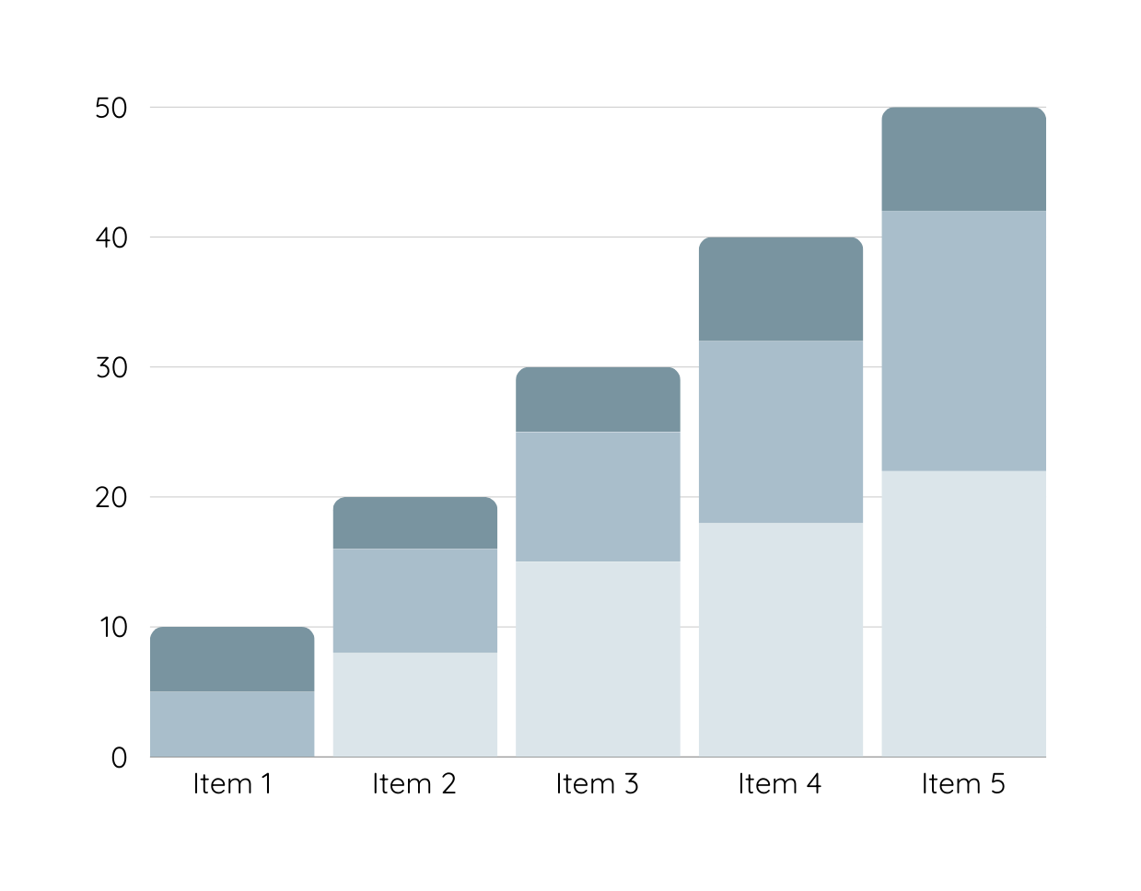
Data Analysis
Over the past year, sales for Warner & Spencer have experienced a consistent decline, dropping month-on-month. The graphical representation of sales volumes reveals a noticeable downward trend, especially in the last quarter.
Product 1
Product 2
Product 3

Slide 10
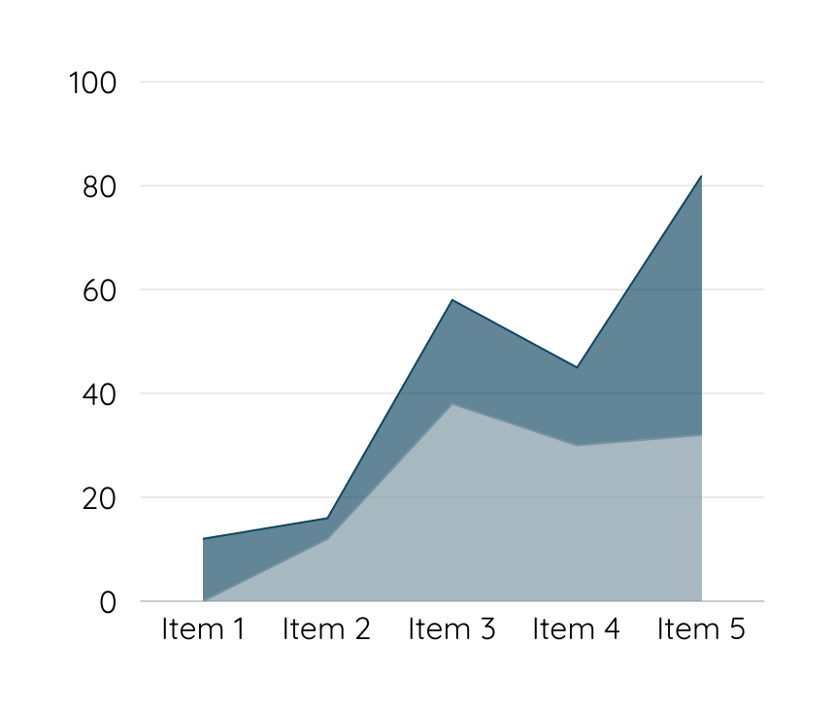
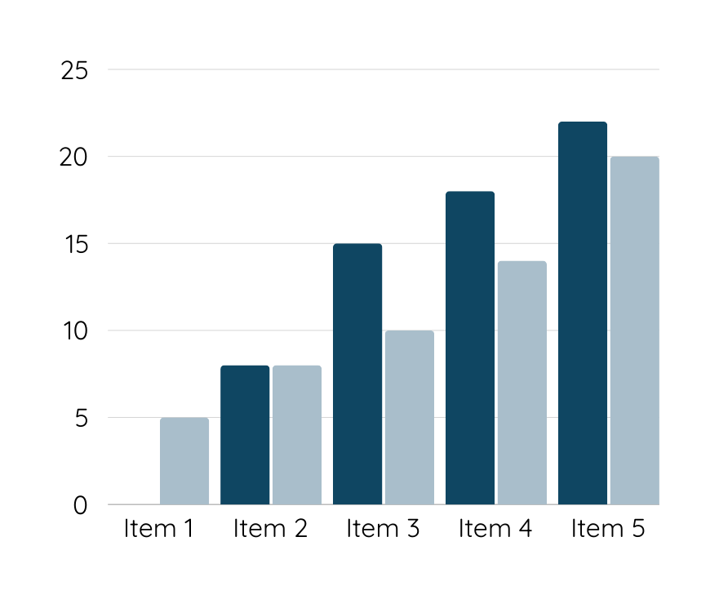
Data Analysis
Customers are unhappy with Warner & Spencer's new packaging, which may be contributing to a decline in sales. Competitors offer better features and pricing, making it difficult for our product to stand out in the market.

Slide 11
Conclusion
By implementing a well-researched and innovative sales strategy, our goal is not only to boost immediate sales figures but also to establish a sustainable framework for continued growth and success.

Slide 12
Thank you

